Slide 1
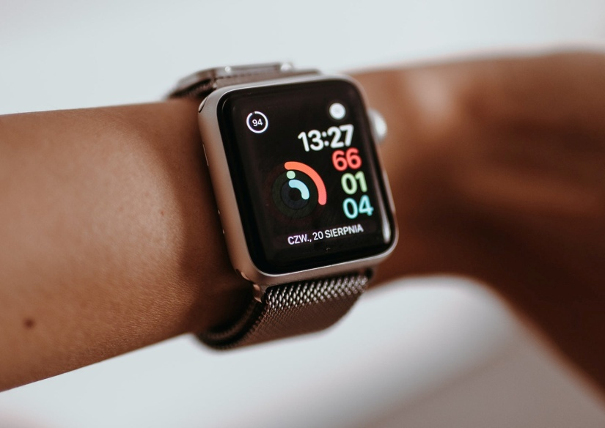
AI BASED WEARABLE HEALTH TRACKER
Artificial intelligence in early detection of medical conditions like Heart attacks ,high B.P
Helps us to detect any uncommon behaviour in
human body at earlier stage
It’s almost like wearing your doctor around your wrist.
In now days all are somehow stressed and causing health issues and this is going
worsen day by day. All are busy on that extent level that they can’t even take care of
their health and life is somehow getting effected by this .
The solution is the device, which can earlier track the health and activity of the body
when you attach a wearable to your wrist, you’re not only carrying an extension of your
phone, but also a device that helps you monitor your health and wellbeing.

Slide 2
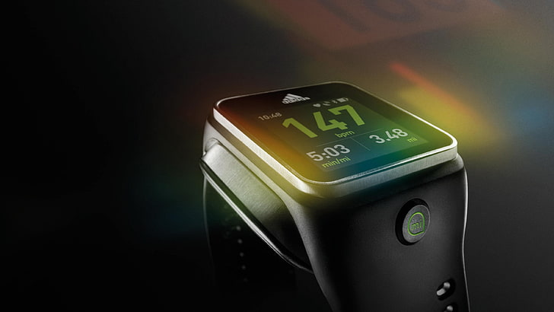
Monitors health of an individual
Collects data such as heart rate , sleep cycle,
breathing rate, activity level , bloodPressure etc.
Self Tracking of health using Machine Learning
[M.L] and Deep Learning Algorithm[D.L.A]
We are using A.I in order to built a watch which monitors health of an individual , this watch basically collect data such as heart rate , sleep cycle, breathing rate ,blood pressure , activity
cycle , oxygen rate etc using various sensors.
By wearing this watch the data will be automatically collected by watch ,further collected data is processed analyzed and then predict your health conditions by using your previously collected data.
There have been many health tracker available that have been developed and monitoring health of a person and in case of unlike detects in body warning is displayed. But through processing and analyzing by using ML and DLA we are making watch as self-predicting device which can predict own their own.

Slide 3
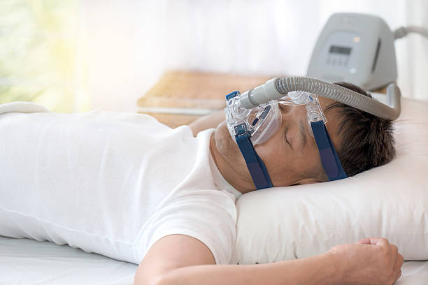
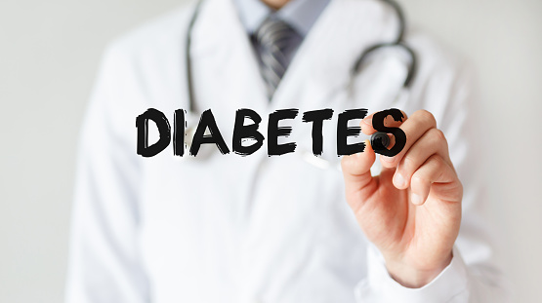
Advance features needed to be introduced
Sleep apnea
Smart watch with a blood oxygen saturation (SpO2) sensor, which can help monitor sleep,
People who suffer from sleep apnea stop and start breathing
irregularly while it can lead to higher blood pressure, an
increased risk of a stroke. this is where a smart watch can
come in.
Diabetes (coming soon)
Smart watches are still incapable of detecting if the wearer has an increased risk of developing diabetes.
But by using deep learning techniques we can extract more from our heart rate readings. By Cardiogram’s algorithms we
can spot diabetes through the wearables .

Slide 4
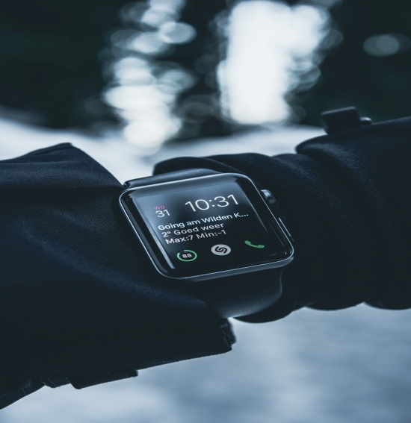

Smart watches with fall sensors and GPS can detect if the wearer takes a sudden spill and if there is any unlike detects in human body message to the concerned is automatically sent or in worse case auto recorded call with exact location will be done to nearest hospital as well as to concerned.
Stress
We should all be keeping a close eye on our stress levels. Accumulated tension can lead to high blood pressure, fertility problems, insomnia, and an elevated risk of heart attack.
The latest smart watch should have a strong focus on stress-busting. Electrodermal activity (EDA) sensor that measures electrical activity can be used to compute your stress levels.

Slide 5
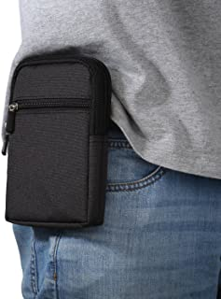
This project consist of a smart box ,containing Drugs
Based on the previously collected track of health ,the drugs and
correlation among health issue is fitted
In case of any uncommon behaviour in human body the message
will be generated and by using help of deep learning algorithm,
the related drug suggestion will appear on smart box as well as
Drug will drag out with smart box.
It can not only track the health activity , it also leads to the transformation of better tomorrow.
Modern day lifestyle leads to many problems and this can be bring down by working on trio Health
,Work , Life through which we can interact and be composed to solve the issues.
Covering and connecting all these segments bring down the mental as well as physical stress.

